Slide 1
Hospital Management System
Course Code: CSE-0318
Course Name: Software Engineering Lab
Submitted To: Khan Md. Hasib
Lecturer Dept. Of CSE
State University Of Bangladesh
Submitted By: Rubyat Jesmin shammi
ID: UG02-47-18-034

Slide 2
Outline
Introduction
Requirement
Login page
Home page
Advantages
Disadvantages

Slide 3
Introduction
Hospital management system is a computer system that helps manage the information related to health care and aids in the job completion of health care providers effectively.

Slide 4
What is the main FUNCTION OF A HOSPITAL?
The main function of a hospital is to provide the population with complete health care; it also functions as the center for the training of health workers. A hospital is generally a vital part of a social and medical organization.

Slide 5
Requirement
Netbeans IDE
Jframe
Mysql Database
Php

Slide 6

Login page
This one is the 1st page of my Project

Slide 7
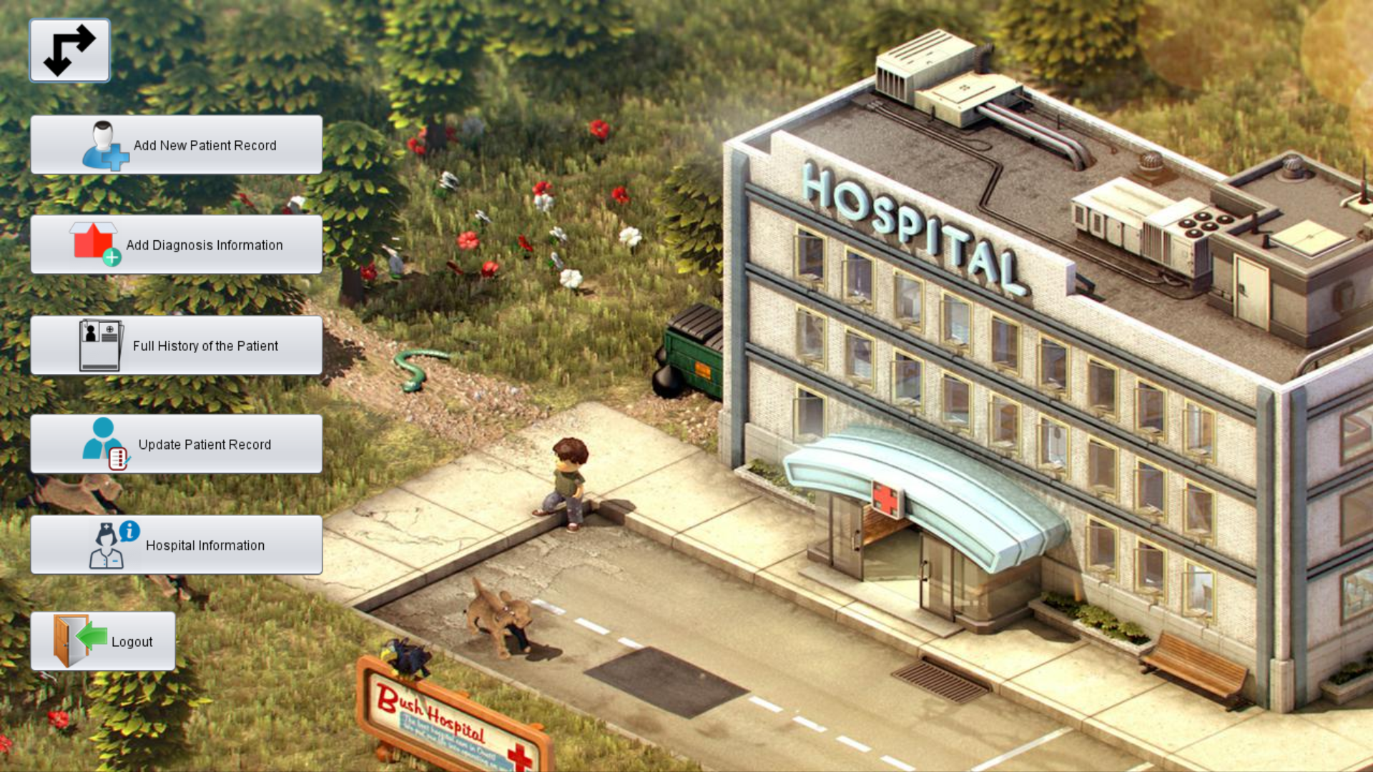
Home page

Slide 8
Advantages
Immediate access of data.
Friendly user interface.
Time saving.
Data can be easily insert/update/ delete.
Saving paper work.
Give Facility of different types of enquiry.
Data’s are easily approachable.

Slide 9
Disadvantages
Enormous start up cost.
Nurses and doctors are unfamiliarity with technology.
Hackers may ultimately be able to penetrate system despite security precautions.
System is attacked by computer viruses
Power failure

Slide 10
Thank You

